Slide 1

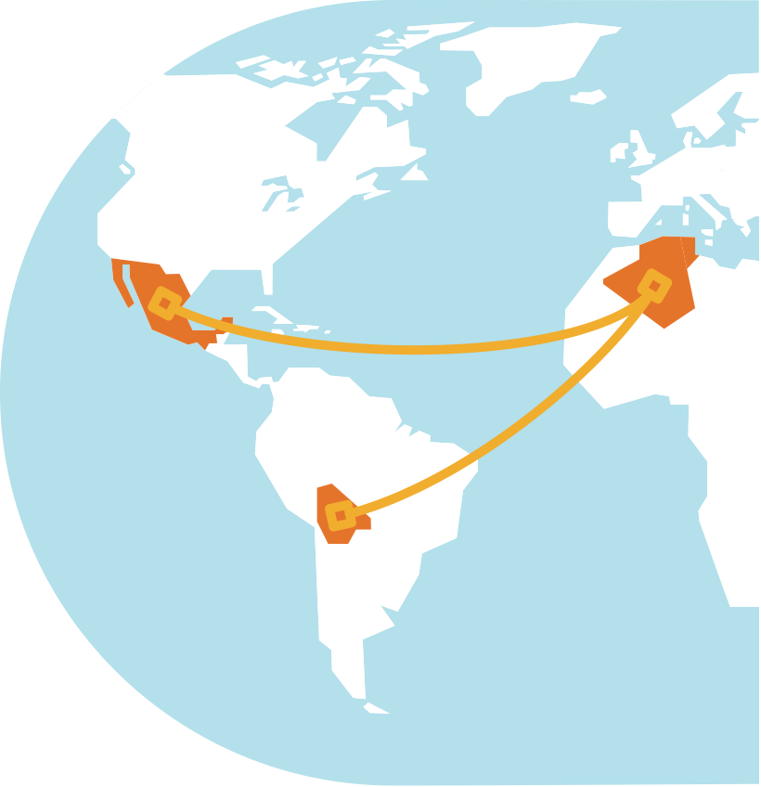
CLCA South-South Knowledge Exchange Webinars - Recap

Slide 2
Agenda
Introduction: 5 minutes
Recap: South-south learnings from the webinar series (Sam Storr) 15 mins
Participant assessment (Menti poll) 5 mins
Low hanging fruits for future collaboration (Mourad Rekik – ICARDA, Santiago López-Ridaura – CIMMYT) 10 mins each + 10 discussion
Website demo (Sam Storr) 5 mins + 10 discussion
Close (Mourad Rekik) – 10 mins + 10 discussion

Slide 3
Scaling – Mostly shared challenges
Bolivia / Mexico
Coordination between the different stakeholders involved
Alignment with large national programs
Links between producers, academics and organizations
Private sector involvement – need for incentives and sustainability
Lack of public policy on biodiversity
Rural financing
Tunisia / Algeria
Low organization of farmers
Low market access (especially with COVID)
Private sector involvement
Lack of coordination between disciplines
Weak extension system in Tunisia
Lack of key partnerships in pilot projects
Rural financing

Slide 4
Scaling – Solutions
Bolivia / Mexico
Business case development
Interdisciplinary teams
Prioritization using Scaling Scan
Promoting dialogue between stakeholders
Find common objectives with public stakeholders
Knowledge hubs
Mixed media tools
Tunisia / Algeria
Being inclusive to partnerships
Organize local communities with groups and cooperatives
Empower local administrative leaders
Plan public-private partnerships

Slide 5
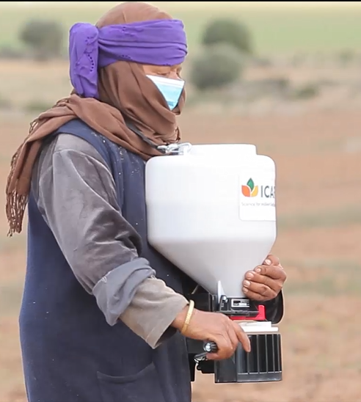
Gender – Findings from Tunisia
Recommendations
Strengthen phone access for women, targeting information to both husbands and wives
Introduce innovations in tandem (e.g. handheld seeders)
Develop role models
Provide support to reduce women’s labor burden
Take into account different recommendations between women and men

Slide 6
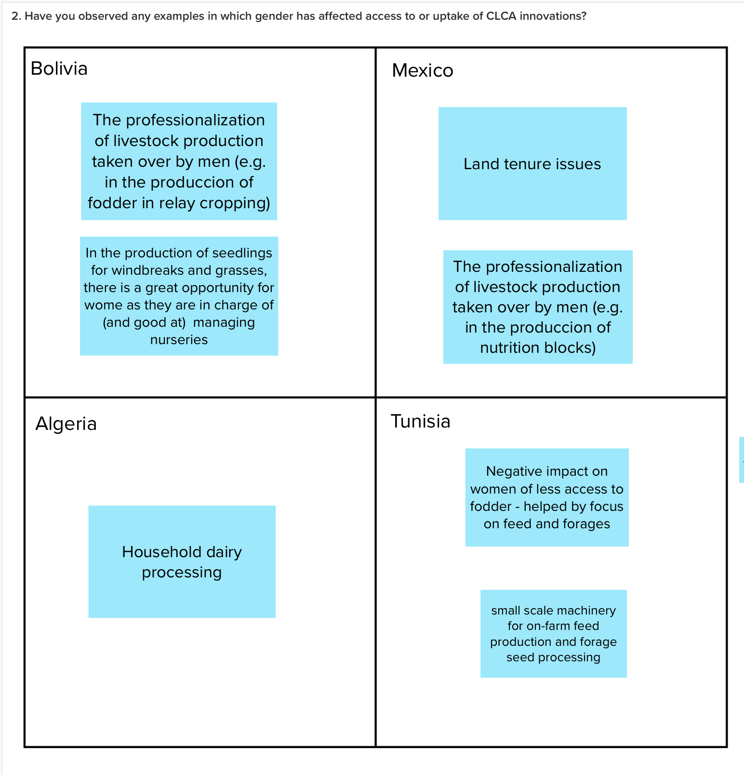
Gender – Audience observations

Slide 7
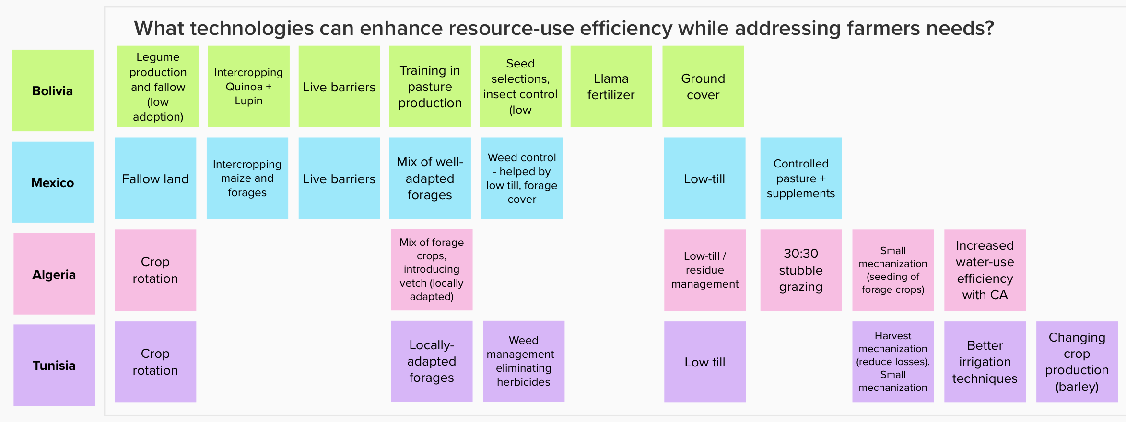
Technical options

Slide 8
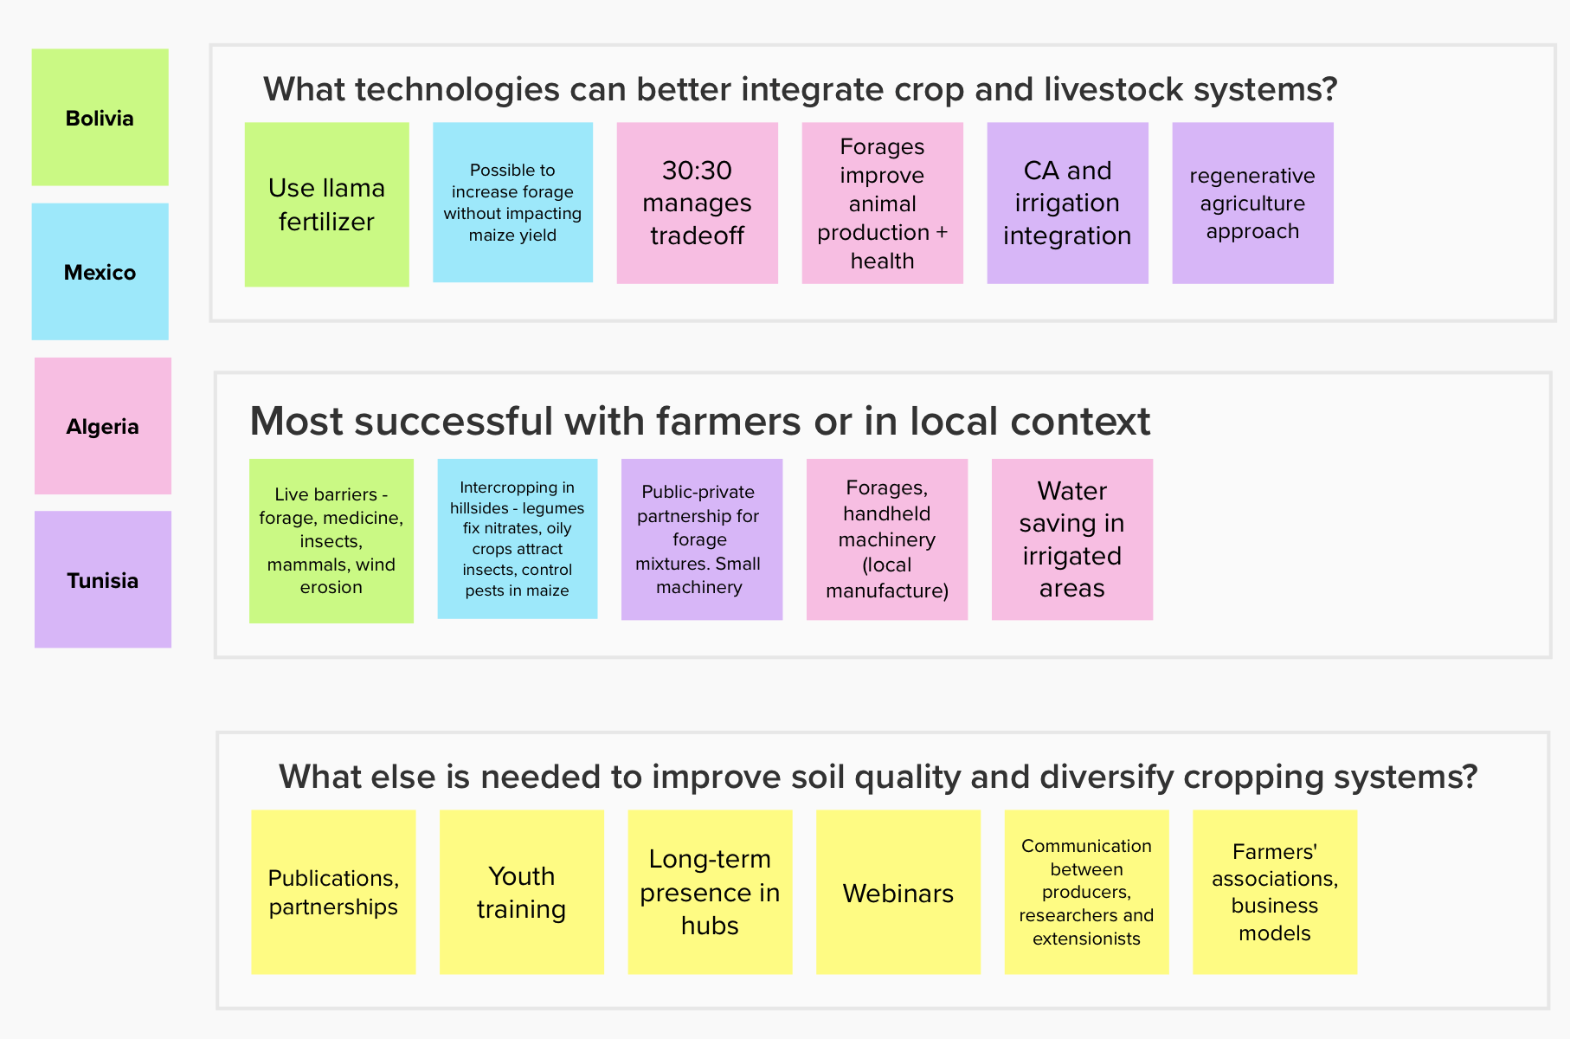
Technical options

Slide 9
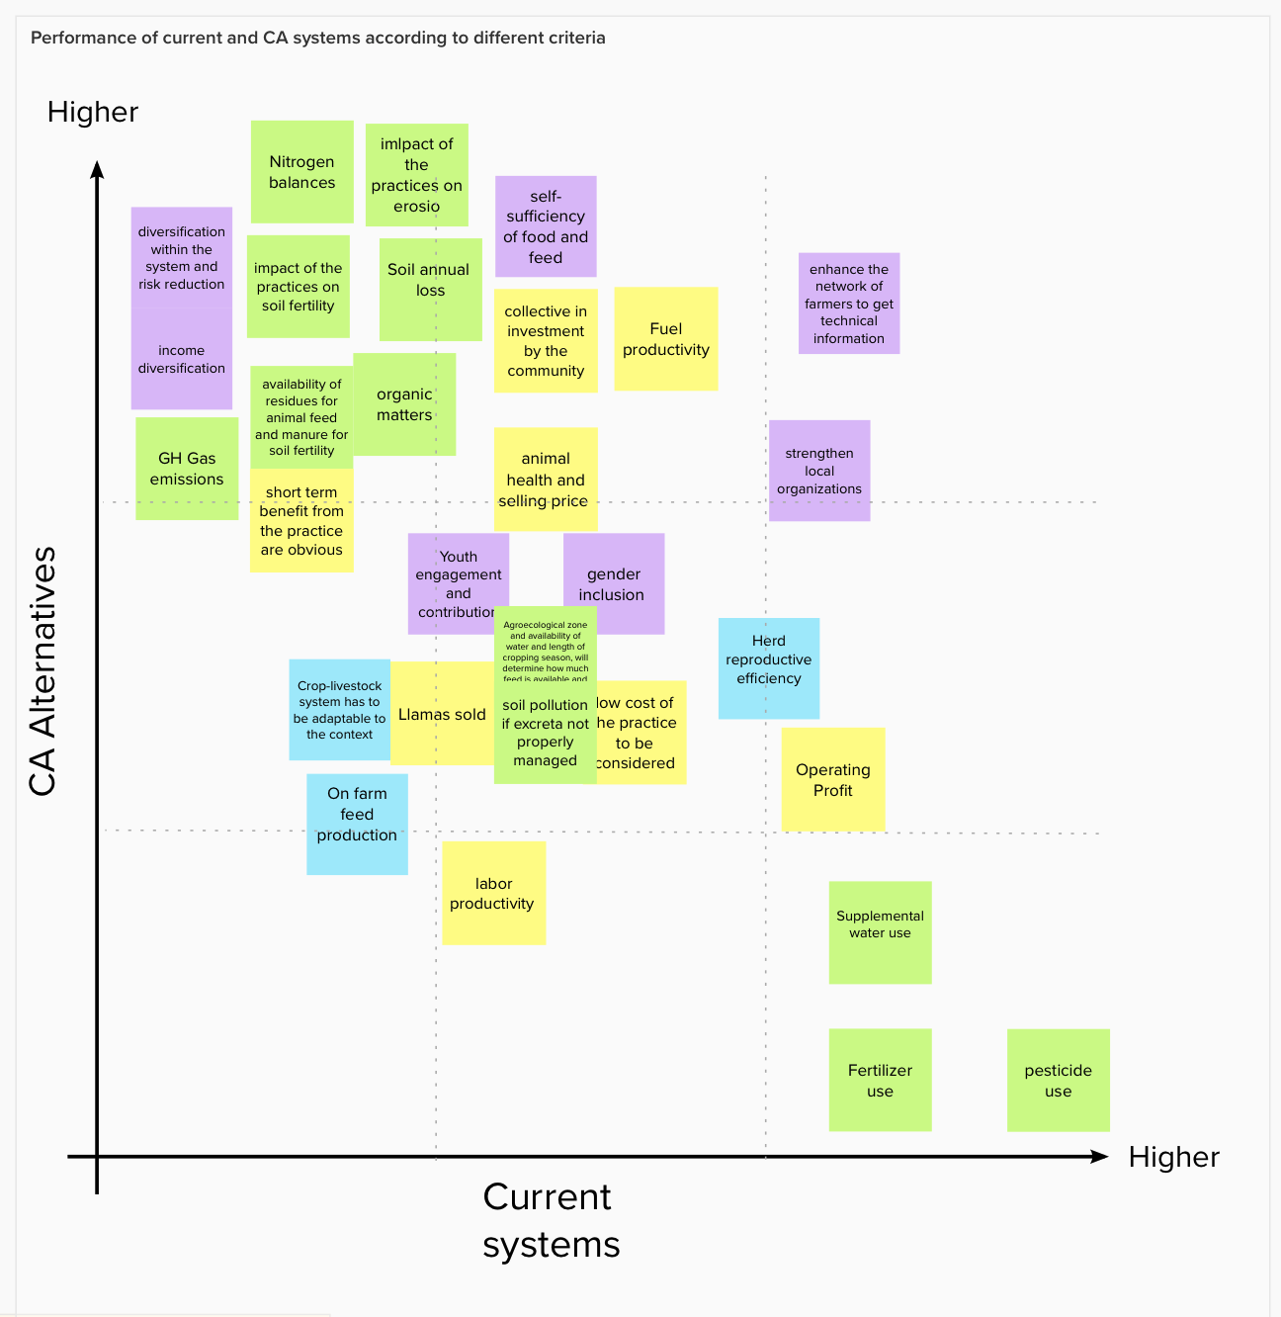
Multi-criteria assessment and trade-offs

Slide 10
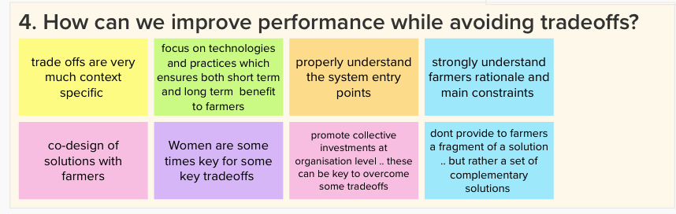
Multi-criteria assessment and trade-offs

Slide 11
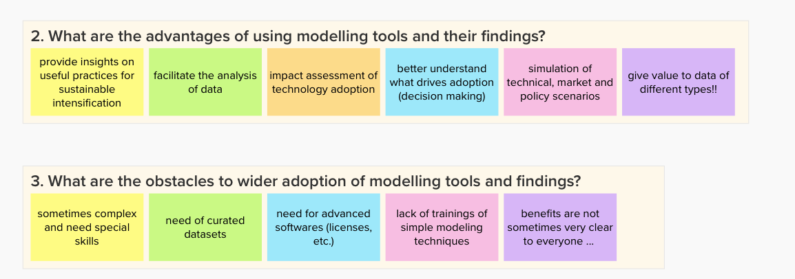
Farm-level modelling

Slide 12
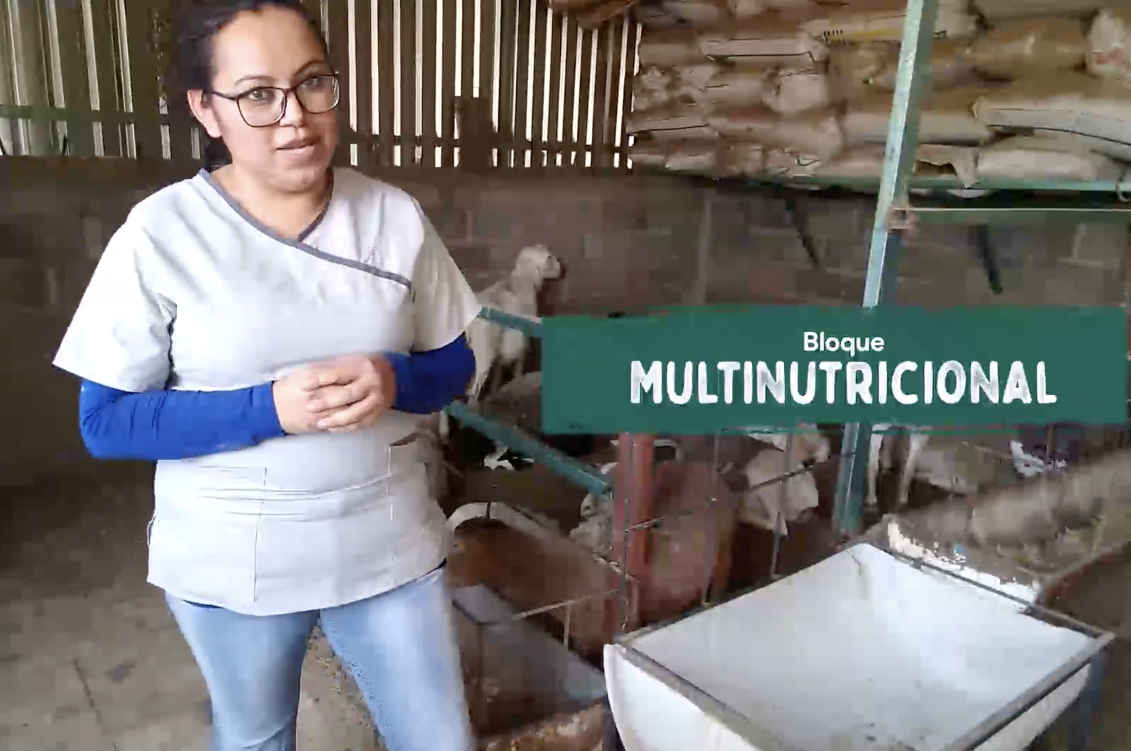
Documentation and outreach innovations
Latin America
Assess user access to communications, including whether younger farmers are a digital entry point
Traditional formats should still be considered (direct contact, SMS)
Mixed media formats are important
Knowledge hubs
North Africa
Include farmer feedback (e.g. adapting machinery to process legume seeds)
Demonstration days, trainings and monitoring visits

Slide 13
Documentation - recommendations
Consolidate information on CLCA project website
Remember to share any further material created
Ensure permanency of online resources
Consider linking with other resources

